Slide 1

KARMUKILAN D K

Slide 2
Contents
ABOUT DATASET
PREPROCESSING
INSIGHTS
CONCLUSION

Slide 3

About Tesla
Founded in 2003 by Martin Eberhard, Marc Tarpenning, and Elon Musk.
Pioneered electric vehicles (EVs) with the introduction of the Tesla Roadster in 2008.
Expanded vehicle lineup includes the Model S, Model X, Model 3, and Model Y.
Known for Autopilot system, advancing towards autonomous driving.
Faced challenges in production, finances, and regulatory hurdles.
Despite challenges, achieved significant market value growth, becoming one of the world's most valuable automakers.

Slide 4
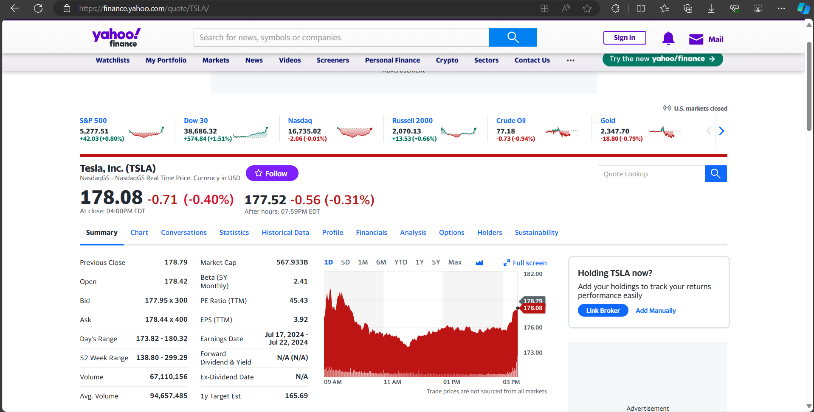
Data collection

Slide 5
Moving Average
In finance, a moving average (MA) is a stock indicator commonly used in technical analysis. The reason for calculating the moving average of a stock is to help smooth out the price data by creating a constantly updated average price.
A moving average (MA) is a stock indicator
The moving average helps to level the price data over a specified period by creating a constantly updated average price.
A simple moving average (SMA) is a calculation that takes the arithmetic mean of a given set of prices over a specific number of days in the past.
An exponential moving average (EMA) is a weighted average that gives greater importance to the price of a stock in more recent days, making it an indicator that is more responsive to new information.

Slide 6
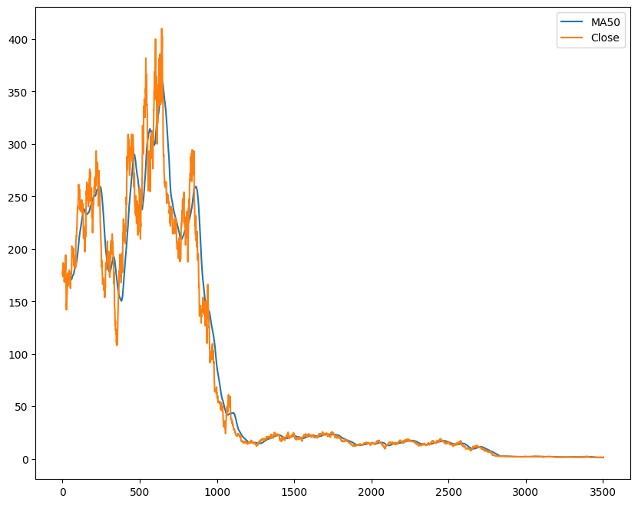
Moving Average

Slide 7
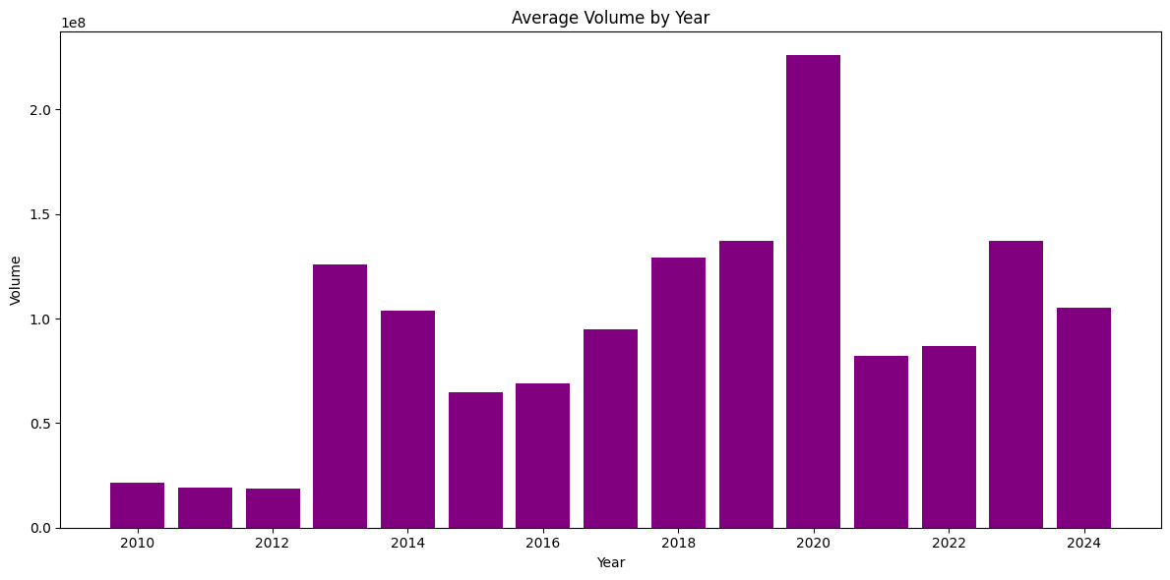
Average Volume by Year

Slide 8
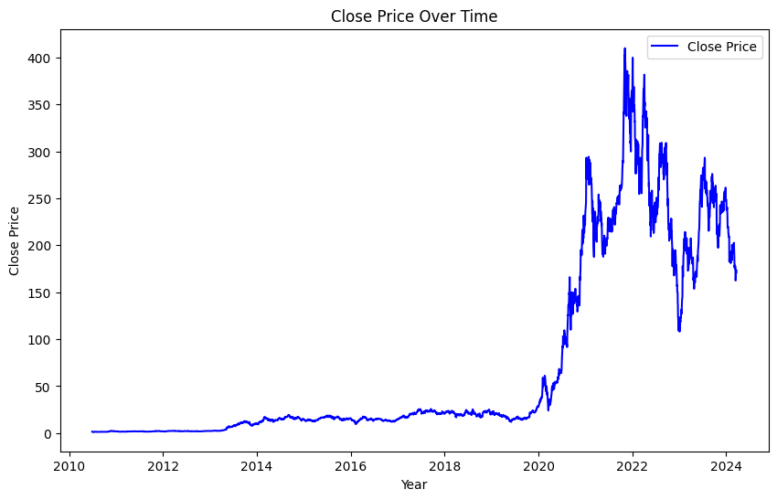
Close Price over Time

Slide 9
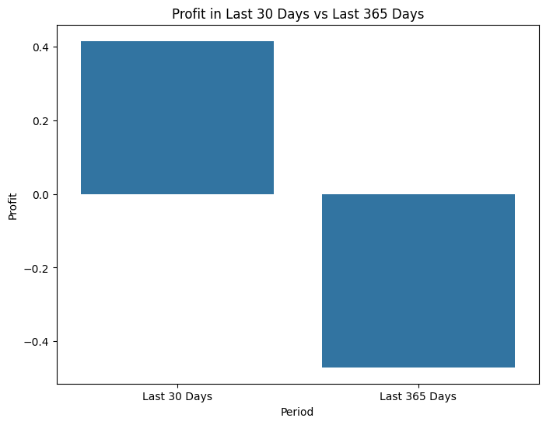
Profit Analysis

Slide 10


Slide 11
Summary
The average close price over the entire period is approximately $72.49.
The average volume traded is approximately 96.89 million shares.
The standard deviation of close prices is around $101.96, indicating considerable price volatility.
The maximum price difference observed is approximately $46.48, while the minimum is around -$47.67, suggesting significant price fluctuations.
The average return is close to zero, indicating overall stability in returns.

Slide 12
Conclusion
Market exhibits significant volatility, evident from wide price differences and fluctuations.
Trading volumes vary across years, with peaks in 2020 and 2013, and lows in 2011 and 2012.
Moving averages generally align with the stock's trend, with minor deviations.
Close prices show steady growth till 2020, surged in 2021-22, then fluctuated.
Short-term profits are positive, but long-term profitability declined, indicating the need for risk management and strategic planning.

Slide 13

THANK YOU !
KARMUKILAN D K

